Slide 1
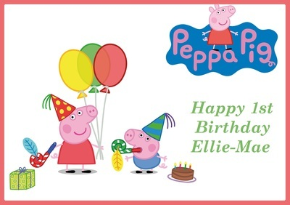
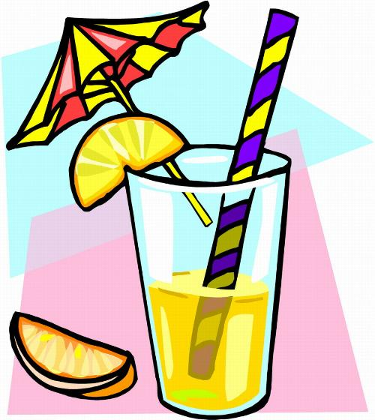
We like juice at party!

Slide 2
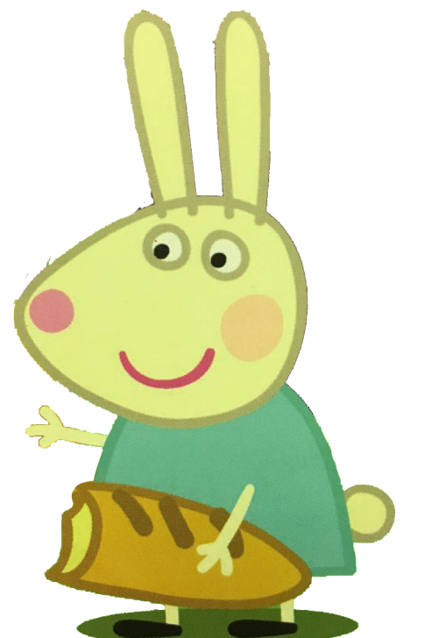
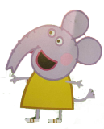
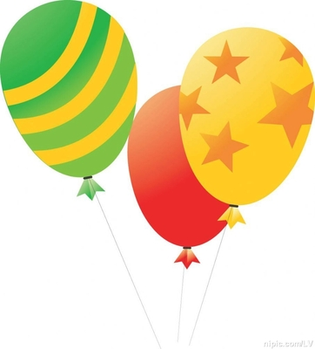
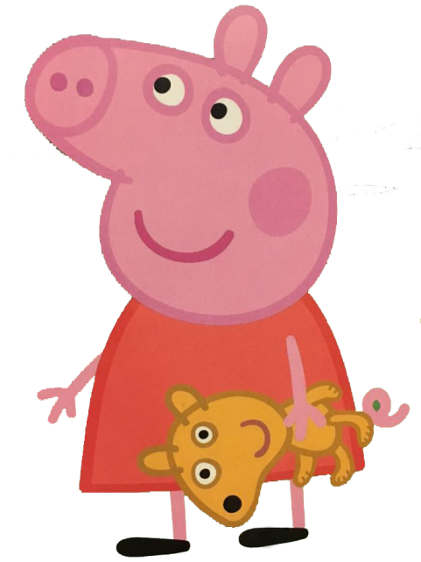
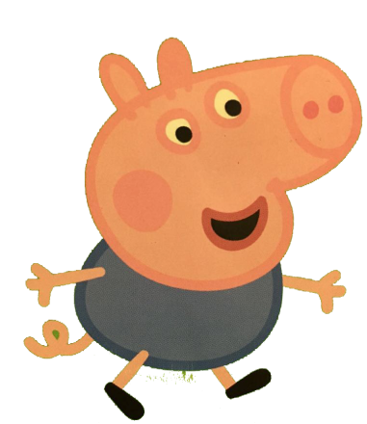
Today is Sunday. Peppa and George are having a party with their friends Edward, Rebecca and Suzy.

Slide 3
Do you like oranges, Rebecca?
Yes, I do. They are sweet.

Slide 4
Do you like bananas, Edward?
Yes, I do. I like oranges, too.

Slide 5
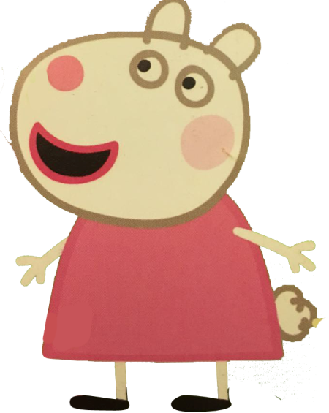
Suzy, do you like bananas ?
No, I don’t. But I like oranges.

Slide 6
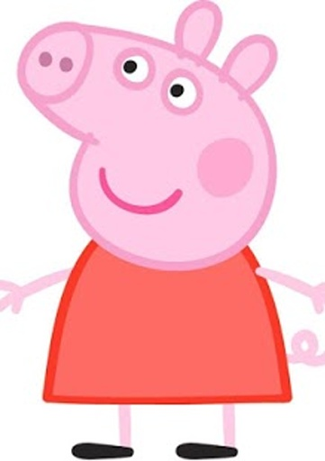
Peppa and George, do you like pears ?
No, Mummy. I like apples and oranges.
Strawberries!

Slide 7
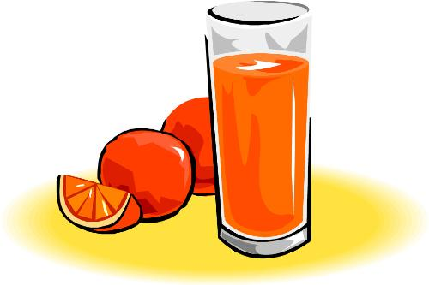
Mummy Pig makes orange juice with ten oranges.

Slide 8
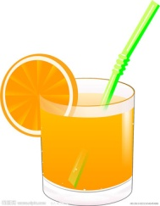
Hooray! Yummy!
Here are your orange juice!

